Slide 1
DECM on 5/6. September 2020 District 95 Division A
Jens-Uwe Adler, Division-Director A

Slide 2
Growing North
Toastmasters in the north
Toastmasters im Norden
Division A – Toastmasters in the north Division-Director Jens-Uwe Adler

Slide 3
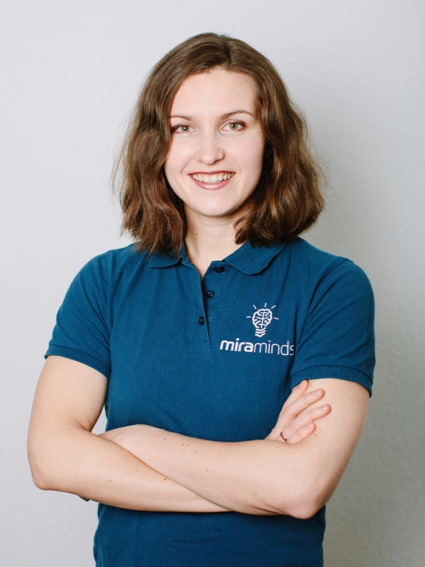
Area A1
Sofia Gertzen, Area Directorin
Hedgehog Toastmasters Club Buxtehude
Igel Toastmasters Club Buxtehude
Hamburg Power Speakers
Hamburg International Speakers
Division A – Toastmasters in the north Division-Director Jens-Uwe Adler

Slide 4
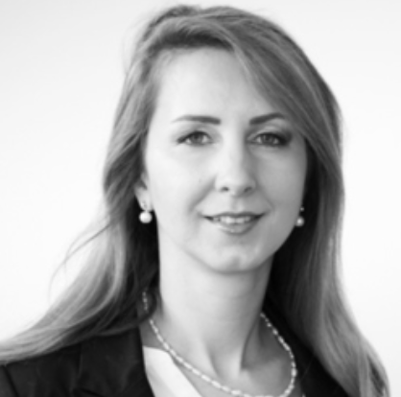
Area A2
Dasha Timmer, Area Directorin
First Hanseatic Toastmasters Club Hamburg
Stade Toastmasters Club
Bremer Sprechstunde
Stader Redenschwinger
Be Master
Division A – Toastmasters in the north Division-Director Jens-Uwe Adler

Slide 5
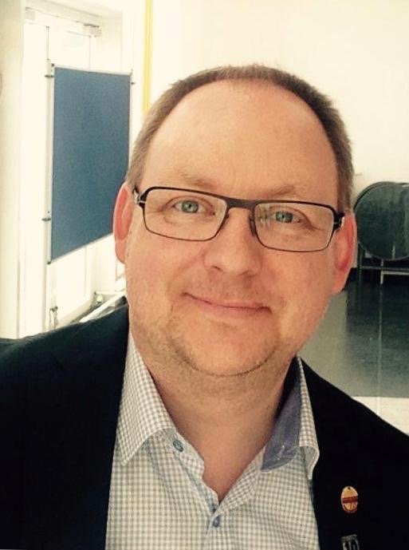
Area A3
Christian Baars, DTM Area Director and Division DLC-Member
Rednerclub Bergedorf
City Redner Hamburg
HanseRedner Hamburg
Kieler Toastmasters
Leuchtturmredner Lübeck
Division A – Toastmasters in the north Division-Director Jens-Uwe Adler

Slide 6
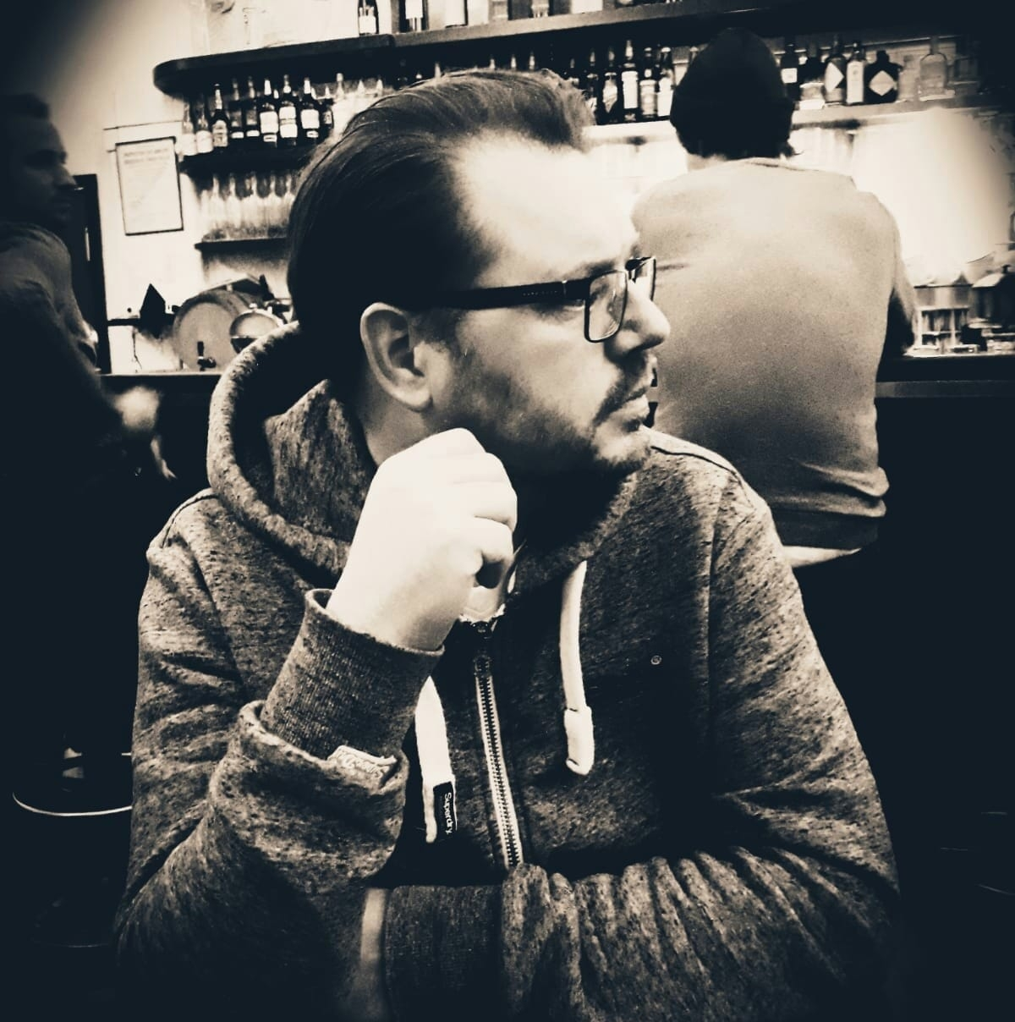
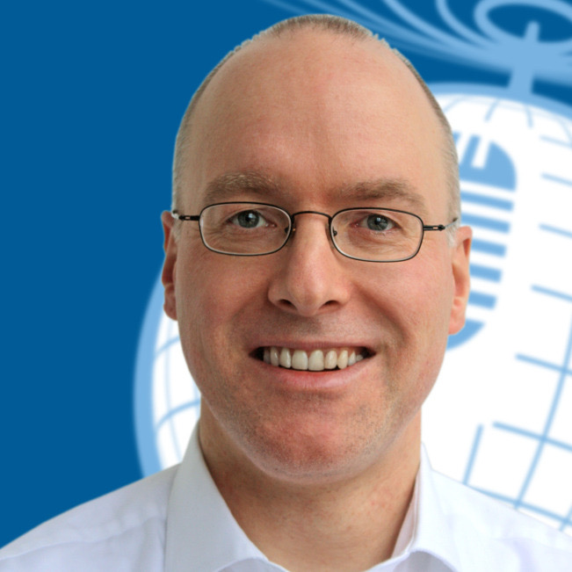
Division Core-Team
PR-Manager
Markus Krause, DTM
EasySpeak-Support Manager Olaf Kock, DTM
Division A – Toastmasters in the north Division-Director Jens-Uwe Adler

Slide 7
COT
11. Juli 2020
22. August 2020
Networking
Cooperation
Stabilization
Barcamp
Presentation Clubs
Public Relation
Workshops (z.B. PR)
Pathways
Easy Speak
Barcamp
Division A – Toastmasters in the north Division-Director Jens-Uwe Adler

Slide 8
COT
11. Juli 2020
22. August 2020
Networking
Cooperation
Stabilization
Barcamp
Presentation Clubs
Public Relation
Workshops (z.B. PR)
Pathways
Easy Speak
Barcamp
72,5%
Division A – Toastmasters in the north Division-Director Jens-Uwe Adler

Slide 9
GOALS
Stabilzation
Leuchtturmredner Lübeck
New Clubs: SALT (Lüneburg) and Hamburg-City
100% Pathways
100% easyspeak
Public Relation
Division A – Toastmasters in the north Division-Director Jens-Uwe Adler

Slide 10
GOALS
Stabilzation
Leuchtturmredner Lübeck
All Clubs in good standing
New Clubs: SALT (Lüneburg) and Hamburg-City
100% Pathways
100% easyspeak
Public Relation
Division A – Toastmasters in the north Division-Director Jens-Uwe Adler

Slide 11
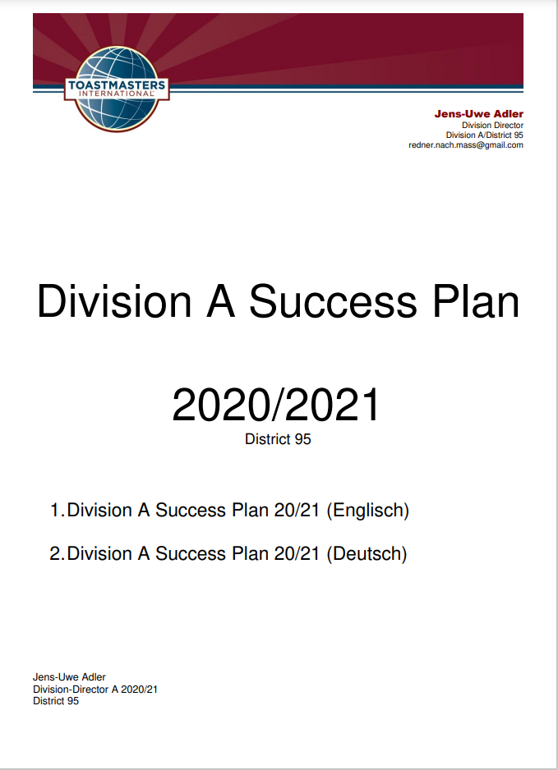
Division-Successplan
14. August 2020
Division A – Toastmasters in the north Division-Director Jens-Uwe Adler

Slide 12
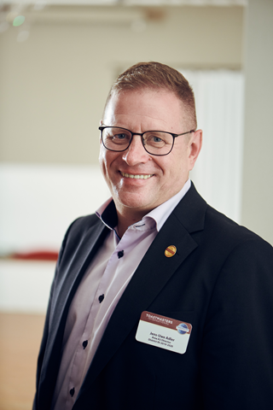
Division A
Jens-Uwe Adler, Division-Director
redner.nach.mass@gmail.com
www.redner.nach.mass.de
www.facebook.com/RednernachMass
www.facebook.com/jensuwe.adler/
https://instagram.com/juadler_redner_toastmaster/
Division A – Toastmasters in the north Division-Director Jens-Uwe Adler

